Slide 1
Musicians and Clergy Working Collaboratively
A Joint Presentation by the American Guild of Organists and Church Music Institute
March 15, 2021

Slide 2
The Church Music Institute
The Church Music Institute (CMI) is dedicated to the advancement and stewardship of the best sacred music for the use of worshipping congregations. Using proven practices, CMI trains new generations of clergy, musicians and laypersons for leading worship through workshops, courses and conferences across the country. CMI also houses the most extensive online library of choral and organ music anywhere.

Slide 3
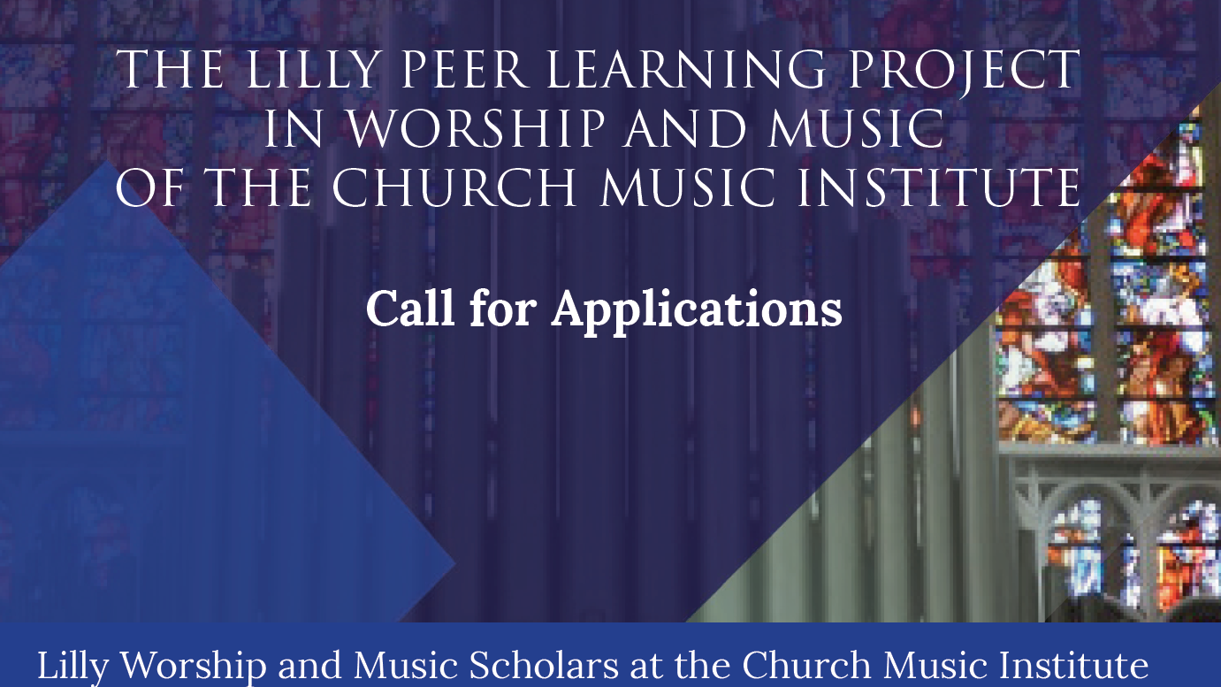

Slide 4
Clergy/Musician Teams with a congregational representative
A project to inform, energize, and engage congregations and their leaders in a more vital worship life, based in proven practices, using local resources.

Slide 5
Peter Marty, Editorial, Christian Century, February 2017
“The best pastors [in this case, musicians, too] I know are those who possess a desire to learn from others. They have a teachable spirit, a thirst for growing virtue, and a lifelong eagerness for feedback.”

Slide 6
The method
A Year Long Commitment
Bookend courses, “Music in Christian Worship” and “Congregational Song” (graduate credit or audit)
Monthly Peer Group Learning Sessions for Clergy/Musician Teams
A project, in coordination with their congregational representative, implemented with their congregation
Compensation for tuition and grant for project

Slide 7
Desired Outcomes
Develop a common theological and musical language for clergy and musicians
Acquire knowledge of the history and practice of church music
Understand and implement the integration of musical and spoken languages in worship
Apply learning in a concrete project so the congregation can learn concurrently
Discover new musical resources within the congregation for use in worship

Slide 8
Today’s Teams
Three teams from the 2018-2019 cohort: finished projects that continue to benefit their congregations.
Four teams from the 2020-2021 cohort: only just begun!

Slide 9
2018-2019 Cohort
Rev. Dr. James Haner (clergy) and Dr. Sam Eatherton (musician), Zion Lutheran Church, Dallas, TX (Dr. Eatherton, now in Sheboygan, WI)
Rev. Adam Douthwaite and Dr. Tim Shewmaker, Our Savior Lutheran Church, Dallas, TX
Rev. Lisa Flores Musser and Dr. Charlotte Kroeker, Saint Michael and All Angels Episcopal Church, Dallas, TX (Rev, Musser, now at Trinity Episcopal in Greely, CO)

Slide 10
2020-2021 cohort
Rev. Dr. Stuart Baskin (clergy) and Weston Jennings (musician), First Presbyterian Church, Longview, TX
Rev. Greg Doll (clergy) and Dwayne Condon (musician), Noroton Presbyterian Church, Darien, CT
Rev. Ann Scalfaro (clergy) and Dr. David Farwig (musician), Calvary Baptist Church, Denver, CO
Rev. Will Wilson (clergy) and Gala Strunk (musician), First Presbyterian Church, Kilgore, TX -

Slide 11
Common characteristics
Well trained in their respective fields of theology and music
Curiosity to delve into interdisciplinary work
Committed to helping their congregations worship effectively
Servant leaders

Slide 12
Would you Like to participate?
For information about the 2022-2023 cohort: churchmusicinstitute.org

